Slide 1
INNOVATION SKILLS - how to harness innovation in sports to business?

Slide 2
1.Objectives & Goals
At the end of this module, you will be able to:
Innovation process
After studying this unit, you can define the concept innovation and list the phases of an innovation process.
Idea generation methods
After studying this unit, you will understand the meaning of structured idea generation methods and in addition you have a possibility to test a couple of methods.
Blue Ocean Strategy
After studying this unit, you will understand the idea of the Blue Ocean Strategy when creating new markets for your company. And in addition you can prepare a four-actions-framework for your own business idea.

Slide 3
Index
Unit 1
Unit 2
Unit 3
Introduction to Design Thinking process:
Take the users’ perspective and empathize with the problem they experience.
Define the problem in detail by aggregating the available dispersed information.
Brainstorm various possible solutions for the problem by combining imaginative insights and generate the broadest possible range of ideas.
Prototype the solution to identify new paths and highlight strengths and weaknesses.
Test the prototype by soliciting feedback from the final users
Introduction to Idea generation methods:
1. Brainstorming
Introduction to Brainstorming
RULES for Brainstorming
STEPS for Brainstorming
2. Brainwriting
6-3-5 Brainwriting
Brainwriting Online
3. 5Y/The 5 Whys Problem Solving Method
4. Six Thinking Hats(R) Metho
Introduction to Blue Ocean Strategy:
Implement your ideas in four-action-framework

Slide 4
Unit 1
Definition
Athletes often have to be innovative, both in training and in competition. Innovation skills are an important part of sports. The same skills are a vital part of business, when planning your business and thinking about competitive advantage.
Innovation is the commercialization of an idea (the ability to create value through new ideas and improved solutions).
Innovation skills are essential for entrepreneurs and for those planning to start their own businesses. Entrepreneurs have to be able to keep up with the changes in the market and the operating environment.

Slide 5
Unit 1
Design Thinking process.
1. Take the users’ perspective and empathize with the problem they
experience.
2. Define the problem in detail by aggregating the available dispersed
information.
3. Brainstorm various possible solutions for the problem by combining
imaginative insights and generate the broadest possible range of
ideas.
4. Prototype the solution to identify new paths and highlight strengths
and weaknesses.
5. Test the prototype by soliciting feedback from the final users

Slide 6
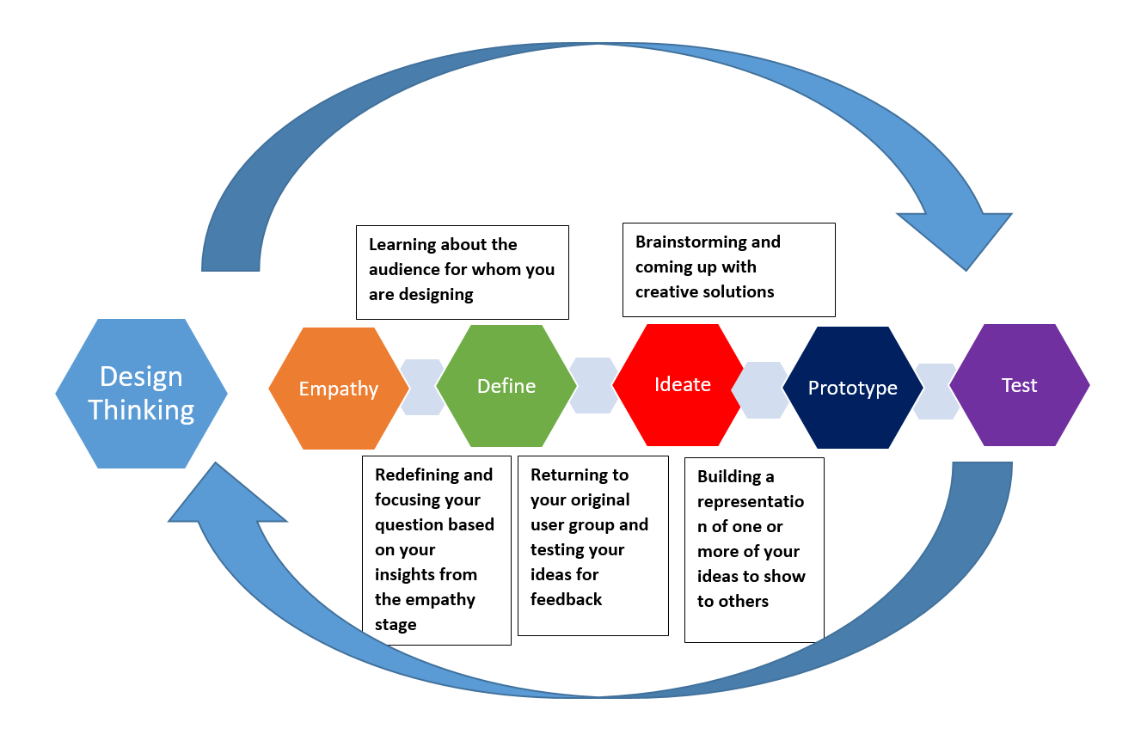
Unit 1
https://commons.wikimedia.org/wiki/File:Design_thinking.png

Slide 7
Unit 1
Introduction to Idea generation methods
1. Brainstorming
2. Problem Solving
3. Idea generation

Slide 8
Unit 2
Brainstorming
Brainstorming is about generating lots of ideas, about collaboration and openness to wild solutions.
Avoid discussions of why ideas may not work. This behaviour kills creativity and shifts the group mindset from a generative one to a critical one. The only way to get to good ideas is to have many to choose from.
There are many variations on how to run a brainstorming, using flipcharts, sticky notes, using techniques such as “brainwriting”, “alphabet”, “grid” or “circle brainstorming”.

Slide 9
Unit 2​
STEPS for Brainstorming:
1. Setup
2. Facilitate
3. Follow-up
https://key0.cc/freepng/270382-Brainstorming-School-Based-Management-Clipart

Slide 10
Unit 2​
Brainwriting exercise in class
Find information and study the 6-3-5 technique. Organise a brainwriting session in class.
Photo by Frans Van Heerden from Pexels

Slide 11
Unit 2​
Test Brainwriting Online
Brainwriting sessions can also be hosted online in a remote or virtual meeting; for example: Online whiteboard for Visual Collaboration www.miro.com.
OPTIONAL: Find other online software for brainwriting.

Slide 12
Unit 2​
Problem Solving Method: 5Y/The 5 Whys
https://youtu.be/B-M3YlA2KDg gets you to the root of a problem quickly.
The 5 Whys technique is true to this tradition, and it is most effective when the answers come from people who have hands-on experience of the process or problem in question.
The method is remarkably simple: when a problem occurs, you drill down to its root cause by asking "Why?" five times.
Then, when a counter-measure becomes apparent, you follow it through to prevent the issue from recurring.
OPTIONAL ASSIGNMENT: Test this method in class. https://www.mindtools.com/pages/article/newTMC_5W.htm)

Slide 13
Unit 2​
Idea Generation Method: Six Thinking Hats(R)
helps you to look at a decision in different ways with a role-playing model developed by Edward de Bono in 1986.
Each has represents a different lens or pespective on a particular issue and is an insightful activity that prevents narrow thinking.
It serves as a team-based problem solving and brainstorming technique that can be used to explore problems through various perspectives in order to uncover options that might otherwise be overlooked.
https://youtu.be/oHiwpz7r4wY
OPTIONAL ASSIGNMENT : Generate new ideas by using this method in class.

Slide 14
Unit 3
Blue Ocean Strategy
Do you want to create game-changing ideas? Here are six ways to create your blue ocean ideas and strategy https://youtu.be/NUWKiC2Jg-A
Blue ocean strategy is the simultaneous pursuit of differentiation and low cost to open up a new market space and create new demand.
It is about creating and capturing uncontested market space, thereby making the competition irrelevant. (https://www.blueoceanstrategy.com/what-is-blue-ocean-strategy/)

Slide 15
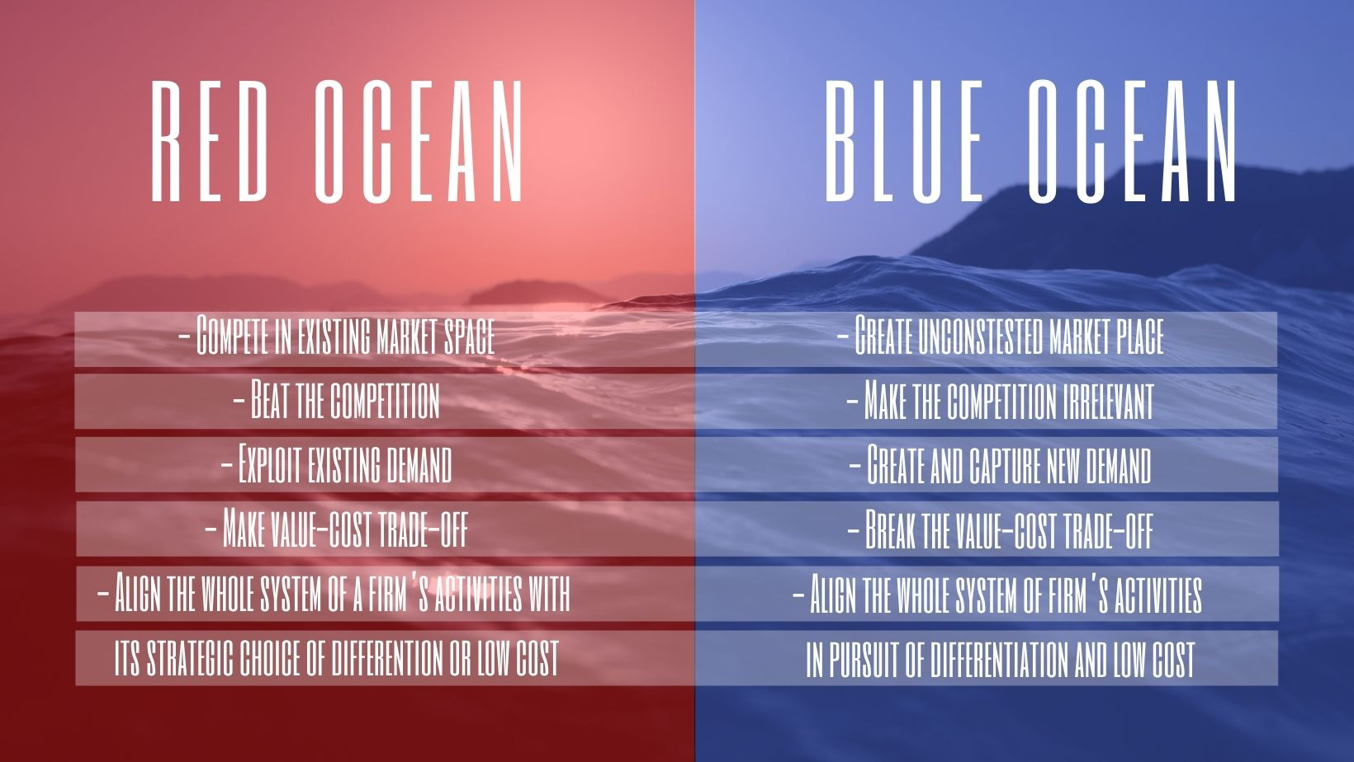
Unit 3
Differences between Red and Blue Ocean

Slide 16
Unit 3
Hands-on task: Four-actions-framework
First, study this material:
https://www.blueoceanstrategy.com/tools/four-actions-framework/
Prepare your four actions framework and present it in class.

Slide 17
Summing up
Introduction to Blue Ocean Strategy
A way to pursuit a differentiation and low cost to open up a new market space and demand
A way to create and capture uncosted market place to make competition irrelevant.
Introduction to Design Thinking
Understand and define customer problem
Benchmarking and data collection
Design multiple solutions
Do cheap and fast experimentation
Introduction to Idea generation methods
Brainstorming
Brainwriting
The Five Whys Problem Solving Method
6 Thinking hats Method

Slide 18
Self-assessment test
Question 1:
What is innovation and why is it important in business?
Question 2
Question 3
What are the phases of the design thinking process?
Tell basic principles of brainstorming.
Question 4
Question 5
Question 6
Describe an idea- generation method. When it could be used?
Explain basic ideas of the Blue Ocean Strategy.
What are the advantages of the Blue Ocean Strategy for business development?

