Slide 1
Creating and retaining value for customers: an introduction to Marketing for aspiring sport entrepreneurs

Slide 2
1.Objectives & Goals
At the end of this module, you will be able to:
Better understand how businesses generate values
…for the clients, the organisation and all people involved.
Frame the role of marketing in this value-generation process
You will be introduced to the very essentials of Marketing discipline and defining pillars
Outline the essentials of your Marketing strategy
We will highlight the variables representing the very core of Marketing strategies to reach clients and market’ segments of interest

Slide 3
Index
Unit 1
Unit 2
Unit 3
Framing the concept of “value” for organizations:
The many interpretations of “value”
Variables of value’s equation
Socio-economic context of a given time and period
Inputs’ processing
People
…so what is Marketing about?
A definition
Needs and wants…
Types of Marketing based on operative context
Types of Marketing based on focus
Products
Sales
Marketing
Relations
The Marketing Mix
The Marketing Mix: 8Ps Model
The Marketing Mix in the Business Plan

Slide 4
Unit 1
What do we mean by value?
Quantitative VS Qualitative
How much has been achieved in a given period of time VS performance’ standards and efficiency
Output VS Outcome
Tangible and concrete results VS medium/long-term impact generating from that output (i.e.,↑ profit)
∏ (profit) = R (revenues) – C (costs)

Slide 5
Unit 1
Variables of value’s equation
Regardless of the actual scale and scope of any business idea, value in its broader sense is built from three explicit variables:
Inputs’ processing
People
Socio-economic context

Slide 6
Unit 1
Variables of value’s equation
Socio-economic context of a given time and period
It refers to the overall scale of phenomena that might have an influence on your business idea.
Technologies and market trends represent two of the most impactful trends that (aspiring) entrepreneurs look into to design and scale-up their business idea.

Slide 7
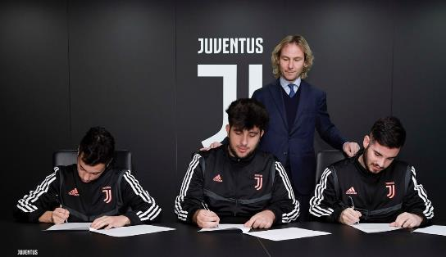
Unit 1
Variables of value’s equation
Socio-economic context of a given time and period, e.g.:
Throughout the last couple of years, e-gaming became a huge thing, with many established sport-related companies capitalising on the phenomenon…
…like already done by Juventus F.C. in 2019, with the public announcement of Club’s very own e-sport team in view the Global eFootball.pro Championship.
Source: https://www.juventus.com/it/news/articoli/la-juventus-entra-nel-mondo-esports

Slide 8
Unit 1
Variables of value’s equation
Socio-economic context of a given time and period
Generally speaking, this dimension refers also to:
Competitors – strengths and weaknesses
Customers – actual and potential
Due to the typical scale and scope of sport-related business ideas, it is relatively easier to find specific market segments at high profitability margins.

Slide 9
Unit 1
Variables of value’s equation
Socio-economic context of a given time and period – finding a niche
More than in other markets, clients of sport industry:
Are very well-informed
Tempt to aggregate in (online) communities
Cluster in well-recognizable segments
Have higher spending potential

Slide 10
Unit 1
Variables of value’s equation
Inputs’ processing
The value generation process falls under a framework that is common to all business.
It is the so defined IPO model:
→ Input
→ Process
→ Output
Environment
Inputs
Inputs
Inputs
OUTPUT
Process

Slide 11
Unit 1
Variables of value’s equation
Inputs’ processing
INPUT | PROCESS | OUTPUTS | OUTCOME
Raw materials Information Knowledge Services Outputs from previous IPO’s cycles Semi finished products | Finance Logistic Administration Human Resource People Management Communication Public Relations Marketing | Final product Final service Deliverable | ↑ Know how ↑ Skills ↑ Competitiveness ↑ Profitability ↑ Sustainability ↑ Brand awareness ↑ Clients’ satisfaction ↑ Effectiveness ↑ Efficiency

Slide 12
Unit 1
Variables of value’s equation
Inputs’ processing
In business studies, we tempt to consider Marketing among those activities defined as Primary*.
Contributing in first hand to reach the final client and generate revenues.
* Interpretation based on Porter’s Value Chain: Competitive Advantage, 1985, p.87

Slide 13
Unit 1
Variables of value’s equation
People
With People, we refer both to:
Internal workforce* – knowledge, expertise, skills and competences
! Those who make things happen !
External Stakeholders – groups of interest, and more in general, whoever might have an interest on business’ activities
*Contrary to Marketing, HR and People Management fall under Support activities – instrumental for a smooth implementation of Primaries.

Slide 14
Unit 2
…so what is Marketing about?
Based on public opinion, there is a lot of misconception on what it is marketing about.
Is it about sales? Communication and promotion? Public engagement? Customer relationship?
In reality, it includes all of the above, and even beyond.

Slide 15
Unit 2
Couple of pinpoints: American Marketing Association (AMA)
[Marketing is] the activity, set of institutions, and processes for creating, communicating, delivering, and exchanging offerings that have value for customers, clients, partners, and society.
AMA’s Marketing definition is very market-centred, including a wide range of activities and tasks aimed at satisficing not only customers’ satisfaction, but that of civil society and general public at large.

Slide 16
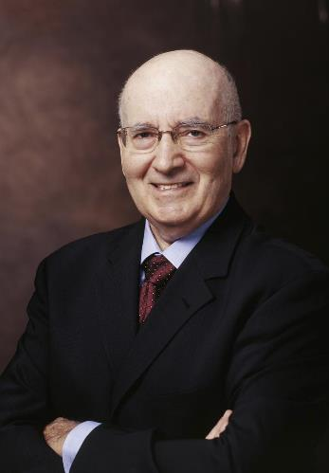
Unit 2
Couple of pinpoints: Philip Kotler
Considered by many as one of the most representative Marketing’s expert worldwide, according to Philip Kotler:
[Marketing is] the process by which companies engage customers, build strong customer relationships, and create customer value in order to capture value from customers in return.
Compared to AMA, Kotler’s definition is much more customer-centred.
Image source

Slide 17
Unit 2
Needs and wants…
In sport industry – as in any other market – Marketing practices based their approach(es) on three everlasting pillars:
MARKET(S) | NEEDS | DEMAND
The competitive context in which your business operates in… What are current (and established) alternative to your offer? What technologies / communication medias your competitors are relying on? | Lags and overall mismatches in customers’ satisfaction that you can exploit in your favour: doing something better / something new than what already done by your competitors. | Customers’ willingness to pay a certain amount to purchase a given good / service. This really depends on: Perceived quality Competitors’ counter-offer Services (i.e., after sale assistance)

Slide 18
Unit 2
Types of Marketing based on operative context
Business Customers (B2C)
Business Business (B2B)
Customer Business (C2B)
Customer Customer (C2C)
In sport-related industries, it is most likely that you will orientate your marketing activities to final consumers (B2C) or retailers / other actors of the production chain.
In sport-related industries, it is most likely that you will rely on this kind of formula when experiencing with influencers’ social media campaigns.
Marketing framework that applies to sharing economy’s businesses – very unusual for sport-related industries.

Slide 19
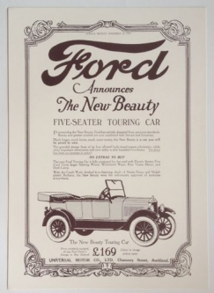
Unit 2
Types of Marketing based on focus
Focus on PRODUCT
Origins: early ‘900s Pioneered by:
Quoting Henry Ford:
If you have a really good thing, it will advertise itself.
In Product-driven strategies, Marketing efforts are aimed at valorising technological / technical / design competitiveness of the given good or service.
Image source

Slide 20
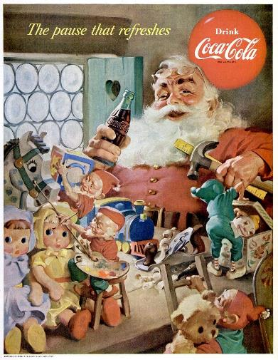
Unit 2
Types of Marketing based on focus
Focus on SALES
Origins: early 30s Pioneered by:
In the early days, Coca Cola was also fostering a Product-lead approach. This was until Marketing Unit realised that, despite their efforts, the company experienced cyclical falls in demand during winter months...how did they overcome this issue? By associating the brand to recognizable imagery…
Image source

Slide 21
Unit 2
Types of Marketing based on focus
Focus on MARKETING
Origins: 80s Pioneered by:
During 1984’ Super Bowl, Apples launched the First Macintosh Commercial. The message of the commercial is subtle but genial reference to Orwell’s best seller.
As of today, this 1-min spot is considered one of the most impactful best practice in media and communication – the ad do the talk for the product, without even showing it on camera…
Image source

Slide 22
Unit 2
Types of Marketing based on focus
Focus on RELATIONS
Origins: 00s – current Pioneered by: …and many others
Users and clients generates content for other users and clients in a never-stopping cycle that nurtures by itself. These feedbacks loops and mutual engagement mechanisms among participants’ helps these brand in retaining a loyal customer base than finds enjoyment in spending time in these platform…for the benefit of advertisers.

Slide 23
Unit 2
What’s the best for your sport-related business?
…there is not a unilateral answer, it really depends on what is the underlie value of your offer.
Are you developing high-tech running sneakers? Product
Are you developing a webzine for off-road bikers? Relation
Are you developing a new hydrophobic swimsuit? Product
Are you developing eco-friendly gym elastic band? Sales
Are you developing an app to monitor athletic performance? Sales
Etc…

Slide 24
Unit 3
The Marketing Mix
How do you come up with a marketing plan? What elements should you focus on?...Let us introduce you to the 8Ps Model:
Product
Price
Place
Promotion
People
Process
Physical evidence
Partnership
Each of the mentioned represents an asset on which entrepreneurs rely on to give content and format to the many possible ways they can reach their market of interest (e.g., off-road bikers, runners, swimmers, etc.).

Slide 25
Unit 3
The Marketing Mix in detail…but in brief
Product What are you selling
Price At what price
Place Where – physical store? Online?
Promotion How are you going to communicate it – eMedia?
People Who’s collaborating with you in this journey?
Process Organisation of primary and secondary activities
Physical evidence Product design and branding
Partnership Cogenerating value for the whole production chain
Bear in mind
Even the slightest change in one of the aforementioned will impact (at least!) one of the others.
Make sure to compile all information into a formal Marketing Plan

Slide 26
Unit 3
The Marketing Mix in the Business Plan
The business plan is the formal document detailing the main assets of the business, in term of:
Executive Summary – summary of the business plan
Business leadership – founders
Offer – product / service, and how they mix
Covered market(s) – customers & competitors
Distribution and Marketing
Business model – coordination of activities and processes
Legal form
Risk assessment – mapping & identification
Capital requirements
Financial projections – cash flow, balance sheet, income statement
Miscellaneous, i.e. Staff’ CVs, surveys and analysis, etc.
These are the typical sections in which you will provide for very precise information about your marketing mix.
Recommendation:
For a better reader’s understanding, you can attach your whole marketing plan in annex to the business plan

Slide 27
Unit 3
Last but not least…
Word of mouth: a threat or an opportunity? It really depends on how your offer is perceived by clients.
Positive reviews – it’s free publicity, customers contribute to market the product themselves, without even being aware of it…
Tip: surf the wave and let the momentum going…
Negative reviews – for a reason or another, you failed to satisfy a customer. Any negative-positive ratio greater than 1:5 (2:5 or worse) should concern you, dropping exponentially your opportunities to engage you customers.
Tip: take action immediately, be polite and seek for more precise feedbacks from the very same “angry” customers…you want to do whatever possible to increase your chances to establish a clean reputation.

Slide 28
Summing up
Business Value: 3 pillars
Inputs’ processing
People
Socio-economic context
IPO MODEL: from input(s) to outcomes(s)
The Marketing Mix
Product
Price
Place
Promotion
People
Process
Physical evidence
Partnership
Understanding Marketing
Definitions. Market-centred (AMA) and customer-centred (Kotler)
Types of Marketing based on operative context and focus

Slide 29
Self-assessment test
Question 1:
What the IPO model?
Question 2:
What is a common definition of Market’s demand?
Question 3:
Which type of Marketing leverages on offer’s technical features to drive sales?
Question 4:
Which type of Marketing is the best suited for sport industry?
Question 5:
What is the Marketing Mix?

